Slide 1

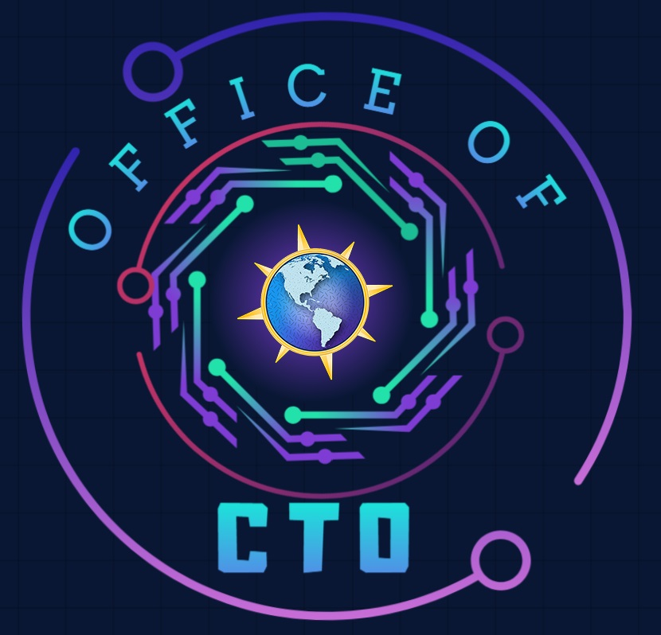

Microsoft FY26 Microhack
Coaches Office Hours

Slide 2
Thank you for signing up to be a coach for the Trustworthy AI Microhack.
We truly appreciate your time and expertise

Slide 3


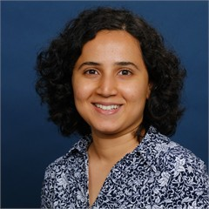
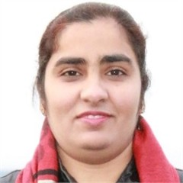
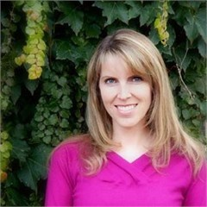
Content Creation
Pod Leads
Jason Virtue / Ananya Chowdhury
Cloud & AI Platforms, Pod Leads
Divya Paduvalli / Prabhjot Kaur
Security, Pod Lead
Diana Phillips
AI Business Solutions, Pod Lead

Slide 4
Trustworthy AI - Content Creation
Pod Leads & Content Creators
Jason Virtue / Ananya Chowdhury
Cloud & AI Platforms, Pod Leads
Content Creators
Alidra | Jennifer Gahman
Andrew Delosky | Prabhjot Kaur
Kumar Allamraju | Diana Phillips
Jared Karney | Jason Virtue
Amanulla Shaik | Divya Paduvalli
Chandra Parchuri | Nalini Chandhi
Olenka Petren | Jesse Coyne
Jennifer Gahman | Tash Tahir
Devanshi Thakar

Slide 5


Microhack Goals
We Build technical skills through hands-on application in key areas, while fostering a sense of community and collaboration.
Make it Real Learning: Hands-on experience that translates directly to customer solutions
Leverage Key Resources: Access essential tools and demos for continuous learning.
Deepen Expertise: Build critical technical skills in priority areas
Collaborative Learning: Work with peers and experts in a team-driven setting
Lasting Impact: Equip teams to deliver more value and innovation to customers

Slide 6





Microsoft Microhack
Trustworth AI
Overview
Hack
Break
Show & Tell
Closing
Outline the Microhack experience, review customer scenario and related technologies.
Participants will work in teams to complete hands-on lab by tackling a series of challenges.
Break for all participants.
Teams will take turns providing a presentation to showcase their accomplishments and methods during the Microhack.
Review of Microhack accomplishments and guide the participants for continuing their journey.
1
2
3
4
5
40 minutes
155 minutes
10 minutes
30 minutes
15 minutes

Slide 7
Agenda
Time | Topic | Description | Presenter
8:00 – 8:10 AM PDT 10 Mins | Welcome & Introductions | Microhack introductions | Thiago Rotta
8:10 – 8:40 AM PDT 30 Mins | Setting the Stage | What is the business challenge we are trying to solve? Recap of our “chain”: context of why this session is important for you Customer story & practical application example Goals & intended outcomes of lab | Pod Leads
8:40 – 9:40 AM PDT 60 Mins | Hands-On Lab: Challenge 0 - 1 | Build upon your knowledge through hands-on lab and demonstrations Begin with environment config/set up (Dev box, code space, repos, etc.) - “Paint by Numbers” Ideate & Implement! Q&A | Pod Leads / Microhack Coaches
9:40 – 09:50 AM PDT 10 Mins | Break | Break | N/A
09:50 – 11:15 AM PDT 95 Mins | Hands-On Lab: Challenge 2 - 3 | Build upon your knowledge through hands-on lab and demonstrations Begin with environment config/set up (Dev box, code space, repos, etc.) - “Paint by Numbers” Ideate & Implement! Q&A | Pod Leads / Microhack Coaches
11:15-11:45 AM PDT 30 Mins | Show & Tell | Publish your work Share your learnings: encourage teams to demonstrate specific features or solutions built | Attendee Volunteer(s)
11:45 – 12:00 PM PDT 15 Mins | Close | Recap of the Day Discussion about the next Microhack Summarize for people who missed | Thiago Rotta

Slide 8
Microsoft Microhack - Attendees
Who you will be working with:
What you will be working on:
Join your assigned team of 3-7 participants
Join your Teams Break-Out channel
Coaches available to help
Main channel will display schedule and remain open for coach requests.
Share Challenge completion updates in Main Teams channel
Building an enterprise‑ready HR Q&A AI assistant that delivers grounded answers with citations from internal company documents
Connecting enterprise knowledge using Foundry IQ and validating citation‑based responses
Applying Responsible AI principles by configuring safety filters, groundedness controls, and prompt protections
Testing agent behavior through manual playground testing and structured ground‑truth evaluation
Running automated evaluations to measure accuracy, groundedness, citation validity, and safety compliance
Enforcing governance and deployment controls using the Foundry Control Plane
Reviewing security and compliance posture using Well‑Architected Framework and Secure AI Framework checks
Observing and troubleshooting the application via Application Insights, Azure Monitor, and AI telemetry
Conducting red‑ and blue‑team simulations to evaluate reliability and trustworthiness before production rollout

Slide 9
Microsoft Microhack - Coaches
Who you will be working with:
What you will be working on:
2 Pod Leads per Microhack
Join your assigned team(s)
1-2 teams per coach
Join your Teams Break-Out channel
Leverage Coaches Teams channel for cross-coach collaboration
Main channel will display schedule and remain open for coach requests
Microsoft Teams – use to collaborate with your Microhack team
Coaches should have environment pre-deployed
Microhack Challenges packet – complete challenges to complete Microhack successfully
Core Challenges
Advanced Challenges (Optional)

Slide 10
Next Steps
All Microhack Coaches should complete the next steps ASAP
Collaborative Learning:
Leverage the Microhack Coaches Teams channel for questions, suggestions, and peer support.
Github Repo and Coaches Guide:
Review all challenges (0 through 3) and ensure you can complete each one. Provide feedback to the Pod Leads if you encounter issues or identify areas that need clarification.
Lasting Impact:
Equip teams to deliver greater value and drive meaningful innovation for our customers.
If you have any questions in the meantime, please post them to the Americas OCTO | Microhack Coaches | Microsoft Teams Channel

Slide 11
Thank YOU!

